Slide 1
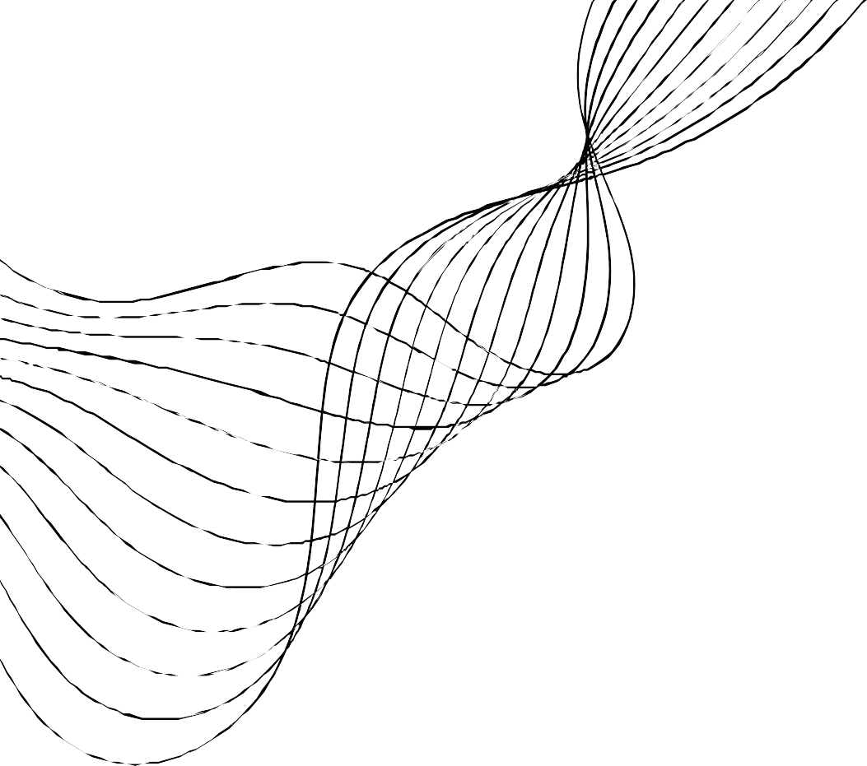
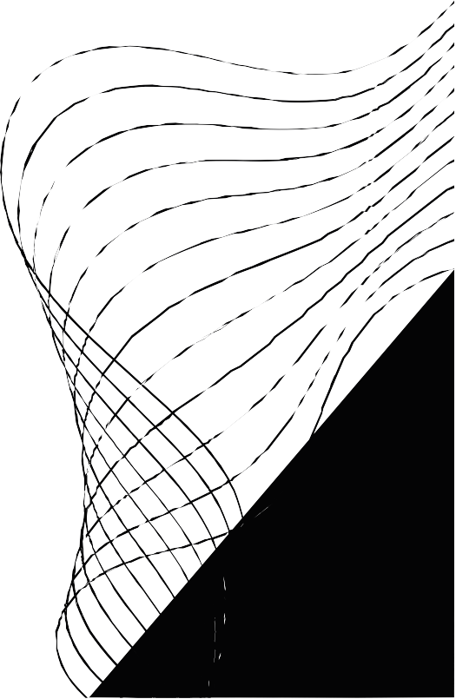
MASS TRANSFER- II
MEMBRANE MODULES:
A DETAILED DISCUSSION

Slide 2
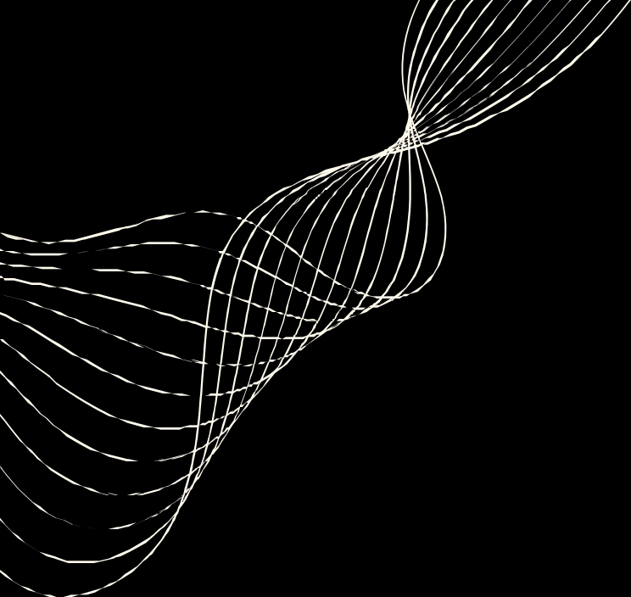

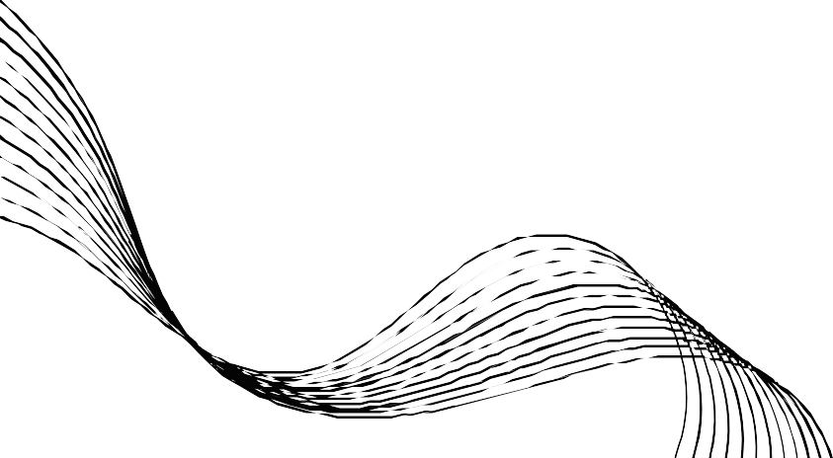
MEMBRANE MODULES
A 'membrane module' is a compact unit housing the membrane as a barrier between the feed and permeate flow regions, and fitted with the inlet and outlet nozzles on both feed and permeate sides.
Compared with conventional separation devices, a membrane module has a small size but a large packing density
A number of modules can be used in parallel if the feed rate is large. It is never built as a big unit because of practical limitations.

Slide 3
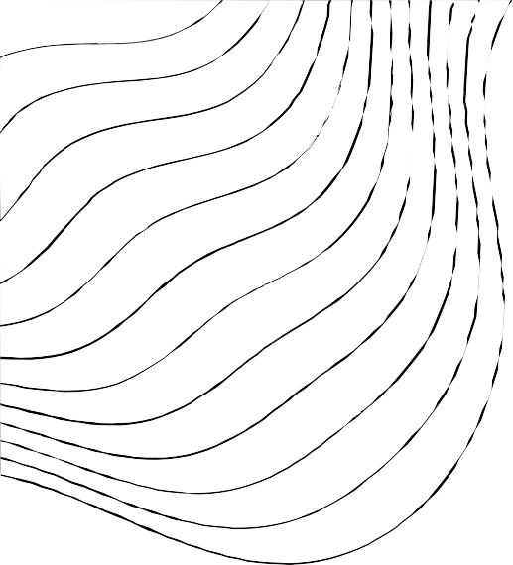
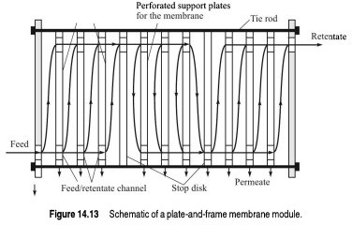
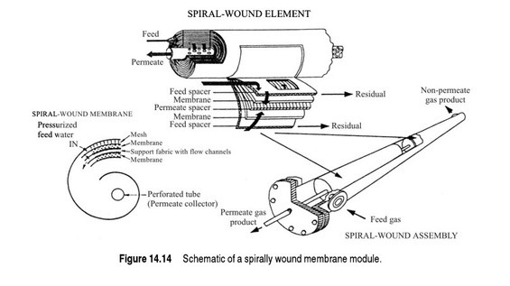
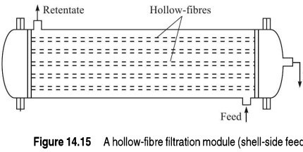
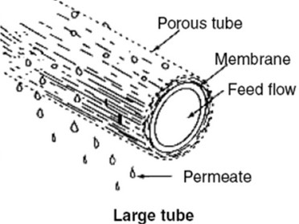
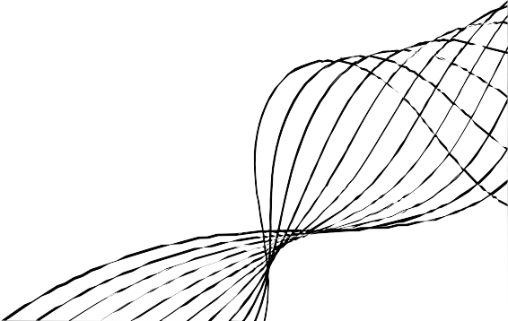
DIFFERENT TYPES OF MODULES
Plate and Frame
Spiral
Hollow
Tubular
*These classifications are based on different shapes and structures and are also highly influenced by their different applications.

Slide 4

1 . PLATE AND FRAME MEMBRANE MODULE
A plate- and- frame membrane module is a design that resembles a plate- and- frame f i ltration unit.
Large number of membrane that are sandwiched together with the use of spacers.
I t can be configured for parallel or combination of parallel and serial Flow between pairs of membrane is parallel
Flow of feed and retentate occur in alternate channels
Membrane are usually 50 - 500 um thick bonded on porous inert matrix. The packing density of such a module is about 100 - 400 m²/ m³.

Slide 5
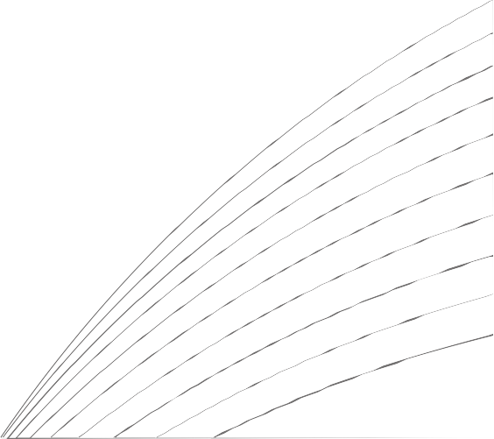
KEY COMPONETS AND ITS WORKING
Plates: These are flat, rectangular components with two parallel perforated membrane supports.
Frames: Surround the perimeter of each plates, providing structural support.
Sealing Gaskets: Create a watertight seal between frames to prevent mixing of feed and permeate streams.
Permeate Channel: An opening near the plate' s edge where purified l iquid( permeate) exits the module.
Feed and Permeate Regions: Alternating sections for feed and permeate separation.
Spacers: Used to maintain separation and prevent mixing of feed and permeate streams.

Slide 6
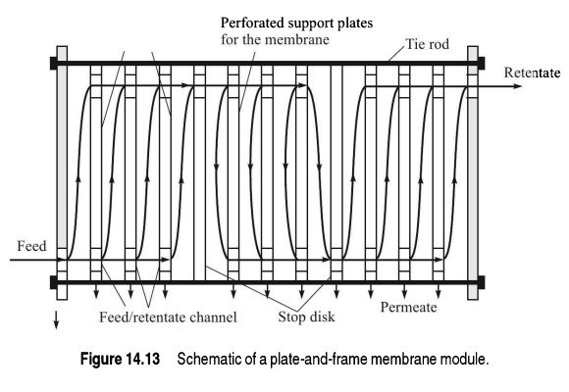

Slide 7
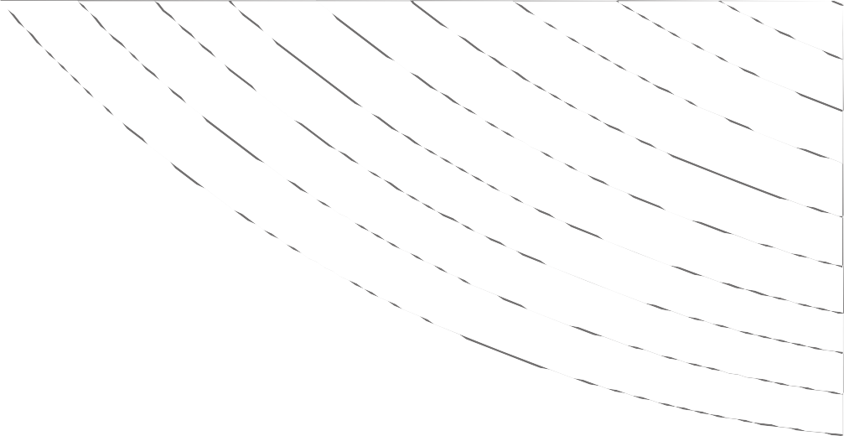
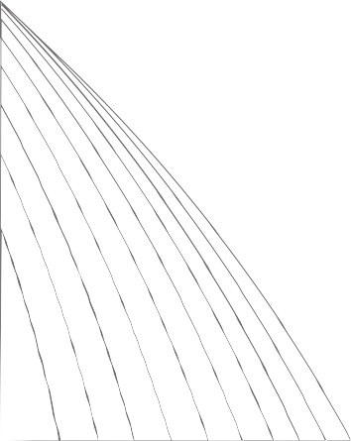
ADVANTAGES
Plate and frame membrane systems excel at efficiently separating solids from water. These systems make it convenient to remove and clean the filter surfaces, ensuring optimal performance over time.
Some plate and frame systems are designed for cross-flow operation, allowing the plate and frame to be rotated. This rotation introduces shearing forces, reducing fouling issues.
System lack feed spacers, minimizing the potential for fouling.
These systems are capable of handling high concentrations of solids, making them versatile for a range of applications.
DISADVANTAGES
Suffer from low packing density, which limits their capacity for filtration Often experience high pressure drops, requiring more energy for operation.
Cleaning and maintaining plate and frame systems presents notable difficulties and can incur substantial costs. The disassembly of entire racks for replacement is a laborious and time-intensive procedure.

Slide 8
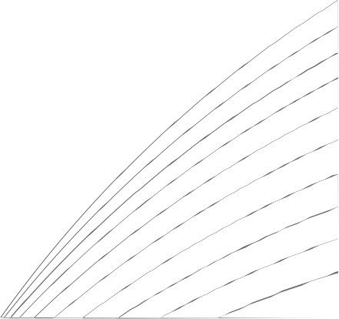
APPLICATIONS
Food and Beverage Industry: Extensively used for l iquid clarification,
concentration, and sterilization in the production of beverages and dairy products
Water Treatment: They play a critical role in potable water production, desalination, and the removal of contaminants and pathogens from
wastewater.
Pharmaceuticals: These membranes are essential for the separation and purification of drugs, proteins, and the treatment of pharmaceutical
wastewater.
Environmental Remediation: Plate and frame systems are applied in the treatment of industrial and municipal wastewater, effectively removing pollutants and impurities.
Chemical Processing: They are used in chemical industries for solvent recovery, chemical f i ltration, and the separation of valuable products.
Typically used for Reverse Osmosis and Ultrafiltration .

Slide 9

2 . SPIRAL WOUND MEMBRANE
A spiral wound membrane is a type of membrane used in f i ltration and separation processes, such as reverse osmosis ( RO) and ultrafiltration
( UF). These membranes consist of a thin, semi- permeable material wound in a spiral configuration within a cylindrical housing or pressure vessel.
The primary purpose of a spiral wound membrane is to separate and purify fluids by allowing certain components to pass through the membrane
while blocking others.

Slide 10
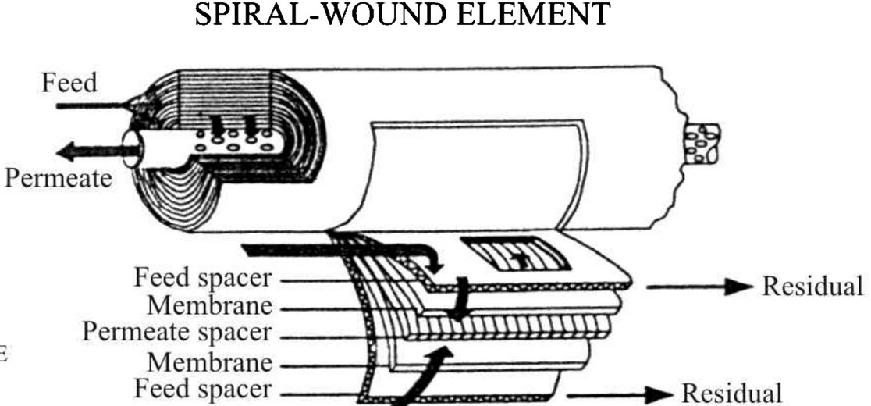
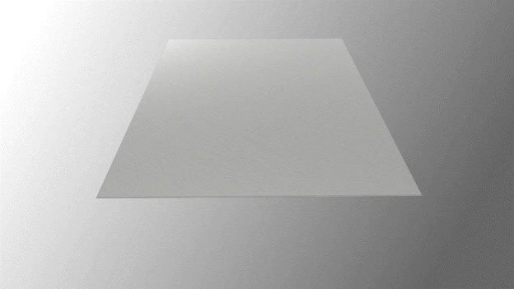

Slide 11
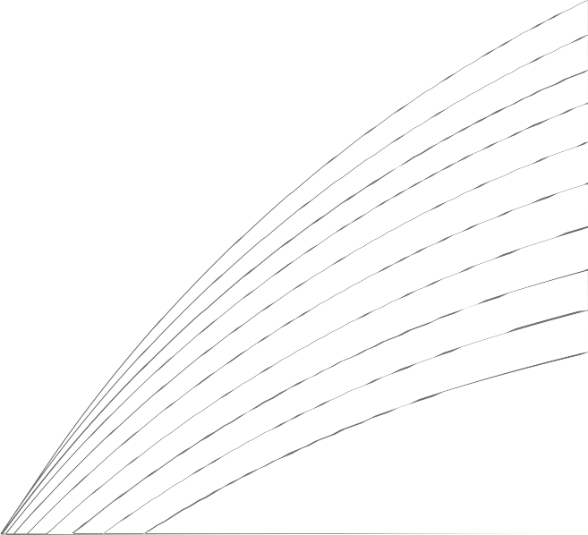
Feed Spacer: The feed spacer is a net-like material or spacer that is placed at the beginning of the spiral wound matrix. Its primary purpose is to maintain a small gap or space between the flat membrane sheet and the feed side of the module. This gap allows the feed solution to flow evenly across the surface of the membrane. Common materials for feed spacers include plastics like polyethylene or polypropylene, which are durable and chemically resistant.
Membrane: The membrane in a spiral wound matrix is a thin, semi-permeable material with microscopic pores. Water and smaller solutes can pass through the membrane's pores, while larger particles and impurities are blocked. The choice of membrane material depends on the specific application.
Polyamide (PA): Polyamide membranes are commonly used in reverse osmosis (RO) for desalination and water purification.
Polyethersulfone (PES): PES membranes are commonly used in ultrafiltration (UF) processes for various applications.
Permeate Collection Pipe or Tube: The permeate collection pipe is a central tube or pipe that collects the purified water, known as the permeate. It is typically located at the center of the spiral wound matrix. The material for this component is typically selected for its durability and corrosion resistance, often using materials such as stainless steel or certain plastics.
Permeate Spacer: The permeate spacer, sometimes called a permeate carrier, is a spacer material that is placed on the other side of the membrane. It helps maintain a gap between the membrane and the permeate collection side of the module. Similar to feed spacers, common materials for permeate spacers include plastics like polyethylene or polypropylene.

Slide 12
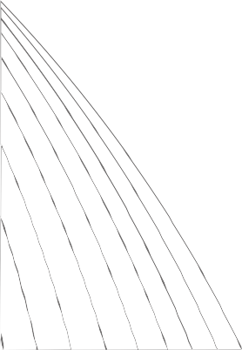
ADVANTAGES
Compact Design: Their spiral configuration allows for a large filtration surface area in a relatively small module, making them space-efficient.
High Efficiency: The design ensures efficient separation and filtration of impurities, providing high-quality permeate.
Scalability: Spiral wound modules can be easily scaled up or down to meet specific capacity requirements.
Low Energy Consumption: They typically require lower energy consumption compared to other separation processes, making them cost-effective.
DISADVANTAGES
Complex Design: Spiral wound modules have a relatively complex structure, which can make them more difficult to assemble and maintain compared to other module types, like tubular or hollow fiber modules.
Limited Flow Rates: They may not be suitable for applications requiring very high flow rates, as they typically have a limited capacity in this regard
Fouling and Scaling: Like other filtration systems, spiral wound modules are susceptible to fouling and scaling, which can reduce their efficiency over time. Regular cleaning and maintenance are necessary to prevent these issues.
Pressure Requirements: They often require high operating pressures to work effectively, which can lead to increased energy costs, especially in large-scale industrial applications.

Slide 13
APPLICATIONS
Reverse Osmosis (RO): Spiral wound modules are widely used in reverse osmosis systems to desalinate seawater and brackish water, providing fresh and potable water for various purposes, including drinking water production, industrial processes, and irrigation.
Ultrafiltration (UF): They are employed in ultrafiltration processes for the removal of particles, microorganisms, and macromolecules from liquids. This is used in industries like food and beverage, pharmaceuticals, and wastewater treatment Nanofiltration (NF): Spiral wound modules can be used for nanofiltration applications to selectively separate ions and small molecules from water or other liquids. This is useful in water softening, color removal, and selective ion removal processes. Wastewater Treatment: Spiral wound modules play a vital role in wastewater treatment by removing contaminants, suspended solids, and impurities from industrial and municipal wastewater streams. This helps in the purification of water for safe discharge or reuse.
Chemical Processing: They are used in the chemical industry for various separation and purification processes, such as concentrating or separating solvents and chemicals.
Dairy Industry: In the dairy industry, spiral wound modules are used for milk and whey concentration, as well as the removal of bacteria and other impurities from dairy products.

Slide 14

3 . HOLLOW FIBRE MEMBRANE
A hollow-fibre module is a compact filtration system with a shell-and-tube design.
It consists of numerous tiny fibres bundled together within a pipe, sealed with end flanges.
The pipe serves as the 'shell' and is equipped with inlet and outlet nozzles. The ends of the fibre bundle are sealed with epoxy, ensuring a secure configuration.
Hollow fibre can find uses in all types of filtration, ranging from microfiltration to reverse osmosis.

Slide 15
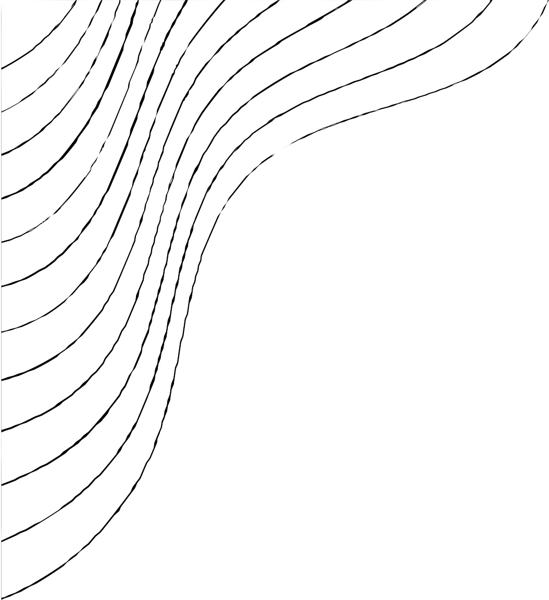
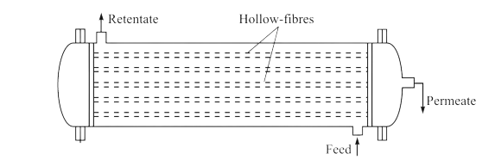
HOW IT WORK
Hollow-fibre filtration module
The module can receive feed either on the shell or tube side.
It accommodates a large number of fine fibres within a small volume, providing a high surface area.
The small fibre diameter allows it to withstand high internal or external pressures without additional support.
High pressure applications (up to 1000 psig) utilize shell-side feeding, while tube- side feeding is suitable for pressures up to 150 psig.

Slide 16


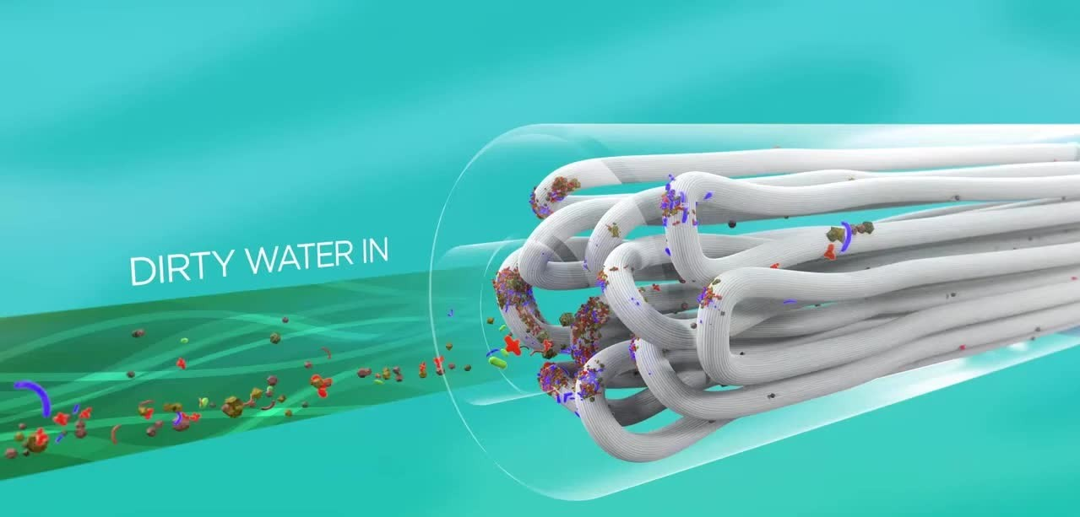
DIRTY WATER FILTRATION THROUGH HOLLOW-FIBRE MEMEBRANE

Slide 17
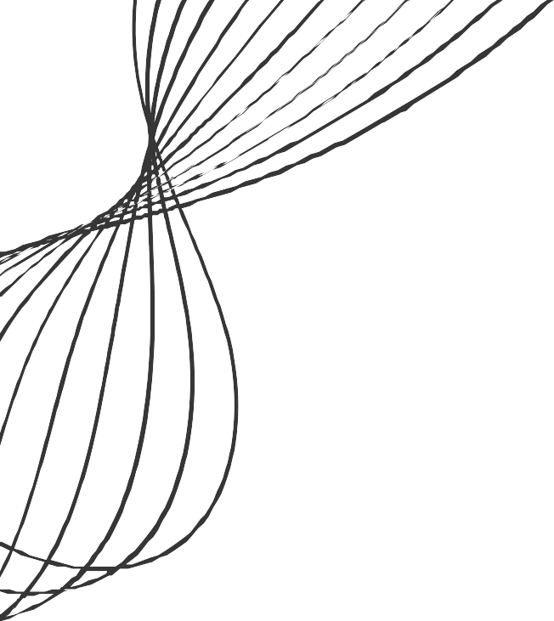
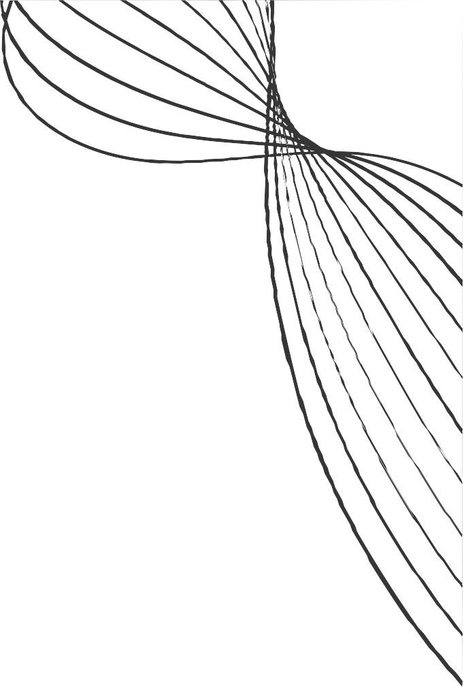
ADVANTAGES
DISADVANTAGES
High packing density, up to
Sensitive to fouling due to
10 , 000
large area.
ft/ ft, results in a effective surface
the t ight
f ibres, which
bundling of l imits flow
and may require frequent cleaning.
Ineffective distribution of
Strong pressure resistance
due to diameter. Compact
the small f ibre
design, allowing
the
leading
shell- side
to
l iquid, potential
for efficient use of space. Versatility in feed arrangement ( shell or tube side).
efficiency issues.
Requires pretreatment to remove suspended particles in the feed.

Slide 18
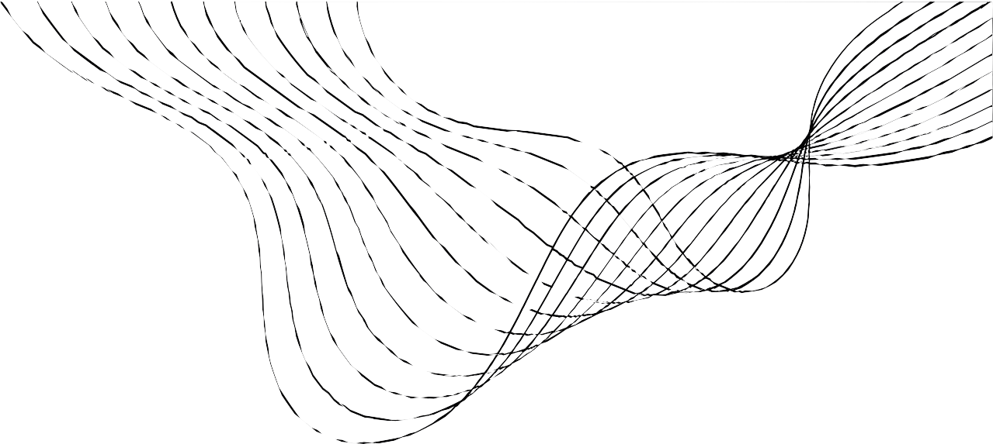
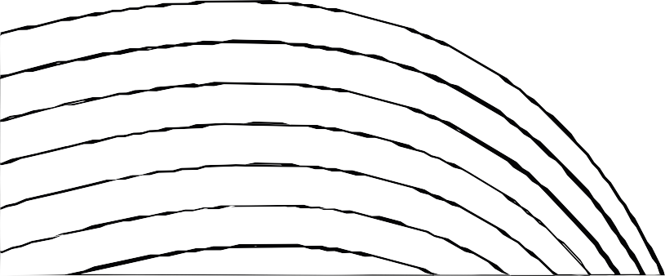
APPLICATIONS-
Common applications include Ultrafiltration (UF), hemodialysis, artificial kidneys, blood oxygenation, and dispersion-free liquid extraction.
Emerging applications include the concentration of fruit juice and desalination using 'membrane distillation.'
A recent use is in deoxygenation of boiler feed water, where the lumen side processes the feed water and the shell side uses stripping gas (N2) to desorb and remove dissolved oxygen, resulting in extremely low oxygen levels (as low as 5 ppb) in treated water.

Slide 19
TUBULAR MODULE
Tubular membrane modules are tube- l ike structures with porous walls.
They operate using tangential crossflow.
Primarily used for challenging feed streams, including high dissolved solids, suspended solids, and oil, grease, or fats.
Typically consist of ½” to 1 ” outer diameter ( OD) tubes. These tubes are individually packed into a PVC housing.
The membrane material can be polymer or ceramic- based.

Slide 20
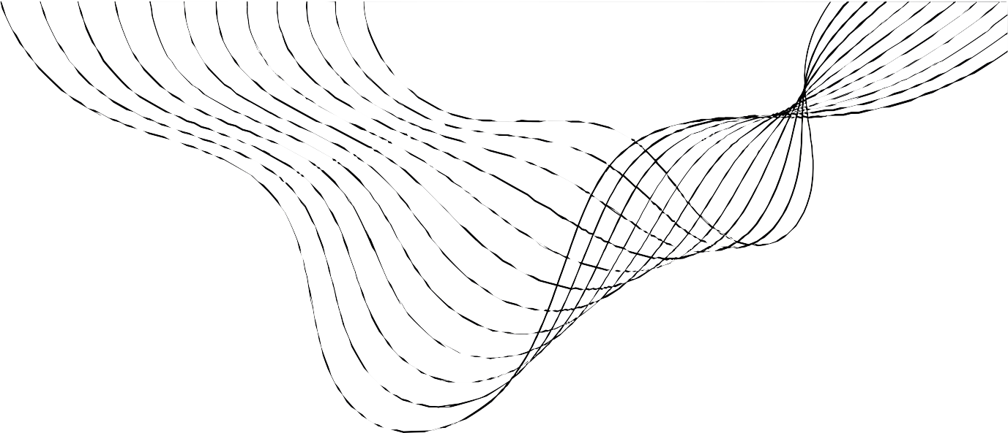
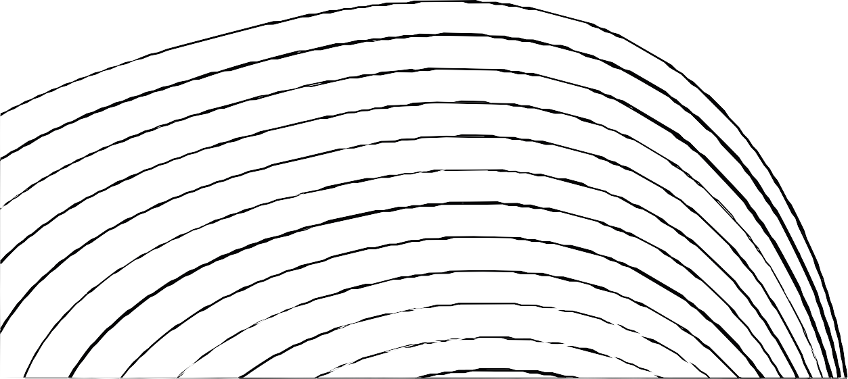
HOW IT WORKS
Tubular modules consist of a minimum of two tubes; the inner tube, called the membrane tube, and the outer tube, which is the shell.
The feed stream goes across the length of the membrane tube and the permeate is filtered out through the porous tube into the outer shell while concentrate collects at the opposite end of the membrane tube.
They are commonly used for applications such as oily wastewater treatment, and other high solids processes.

Slide 21
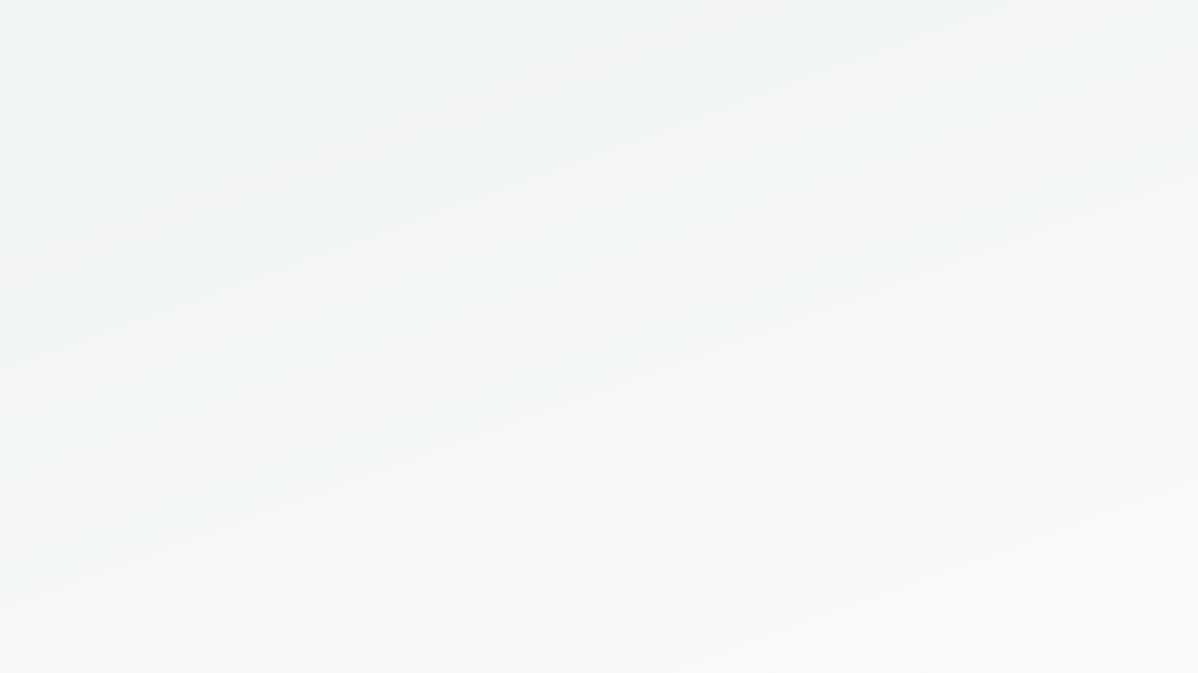
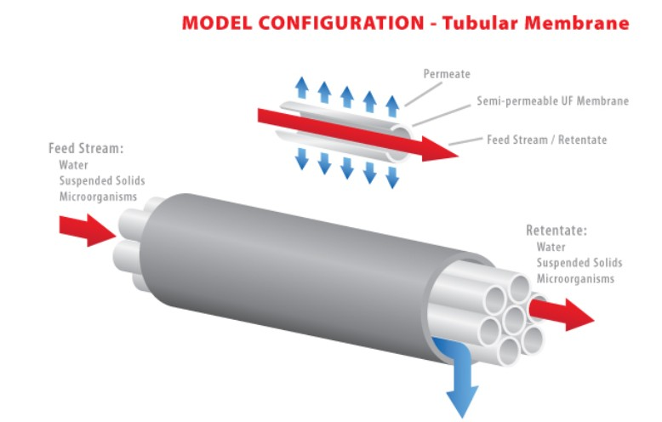
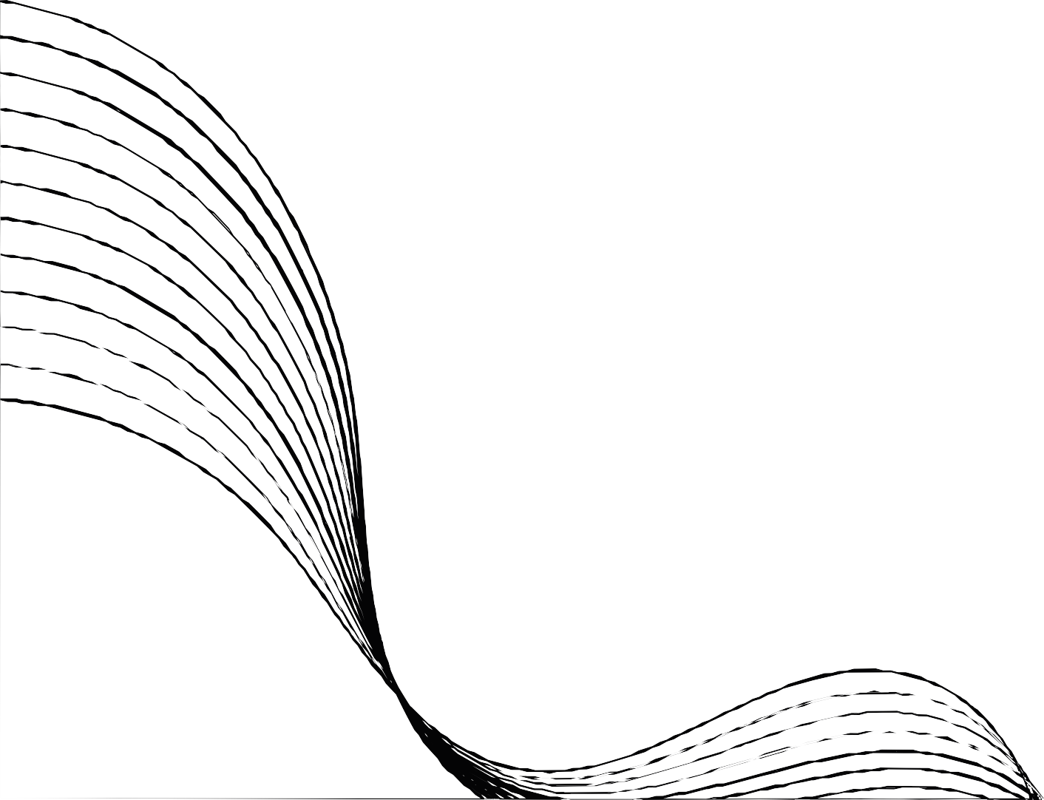

Slide 22

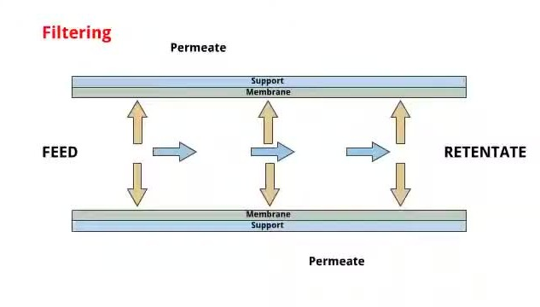


Slide 23
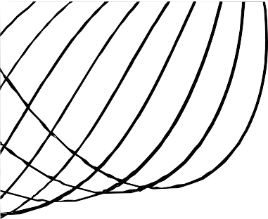
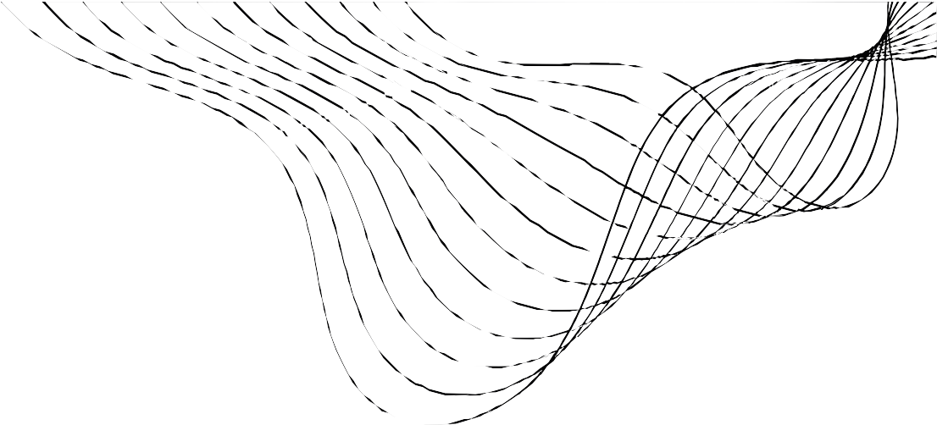
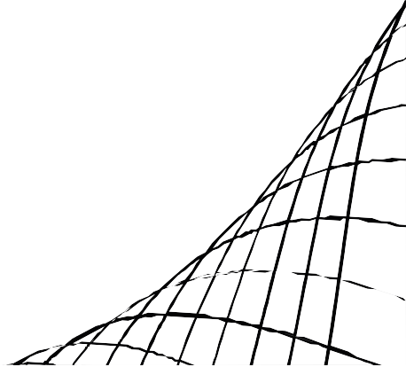
ADVANTAGES
Tubular systems have less fouling compared to plate and frame systems, and a similar amount of fouling when compared to spiral and capillary.
Tubular systems allow for robust cleaning methods such as the use of harsh chemicals, backwash, and even mechanical cleaning which might not be available for other system configurations.
They can handle the highest solids and emulsified oil load compared to many other membrane types and can be physically cleaned with sponge balls.
DISADVANTAGES
Low packing density and laErvgeerseizsetare disadvantages of tDubreulwar modules.
Remy
Marsh
Cantu Holloway
Packing density of tubular modules is higher than plate and frame systems but lower than capillary, hollow fiber, and spiral
wound elements.
Ceo Of Ingoude
Ceo Of Ingoude Ceo Of Ingoude
Company Company Company
Because of the large inner diameter of the tubular modules, flow requirements are higher than those of other system configurations.
The capital and operating costs (pump energy) for tubular membranes tends to be very high, along with the requirements for larger footprints for capital equipment.

Slide 24
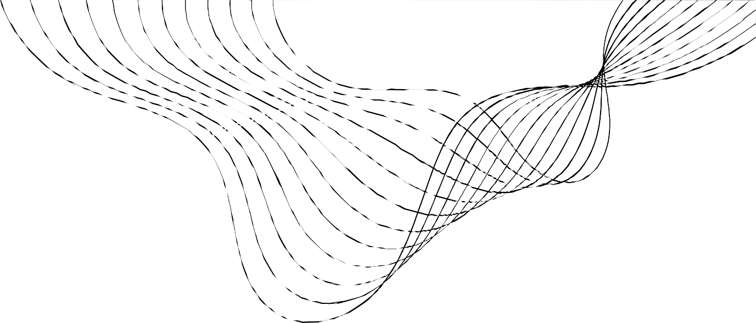


APPLICATIONS
Microfiltration
Ultrafiltration Nanofiltration
Gas separation (GS)

Slide 25
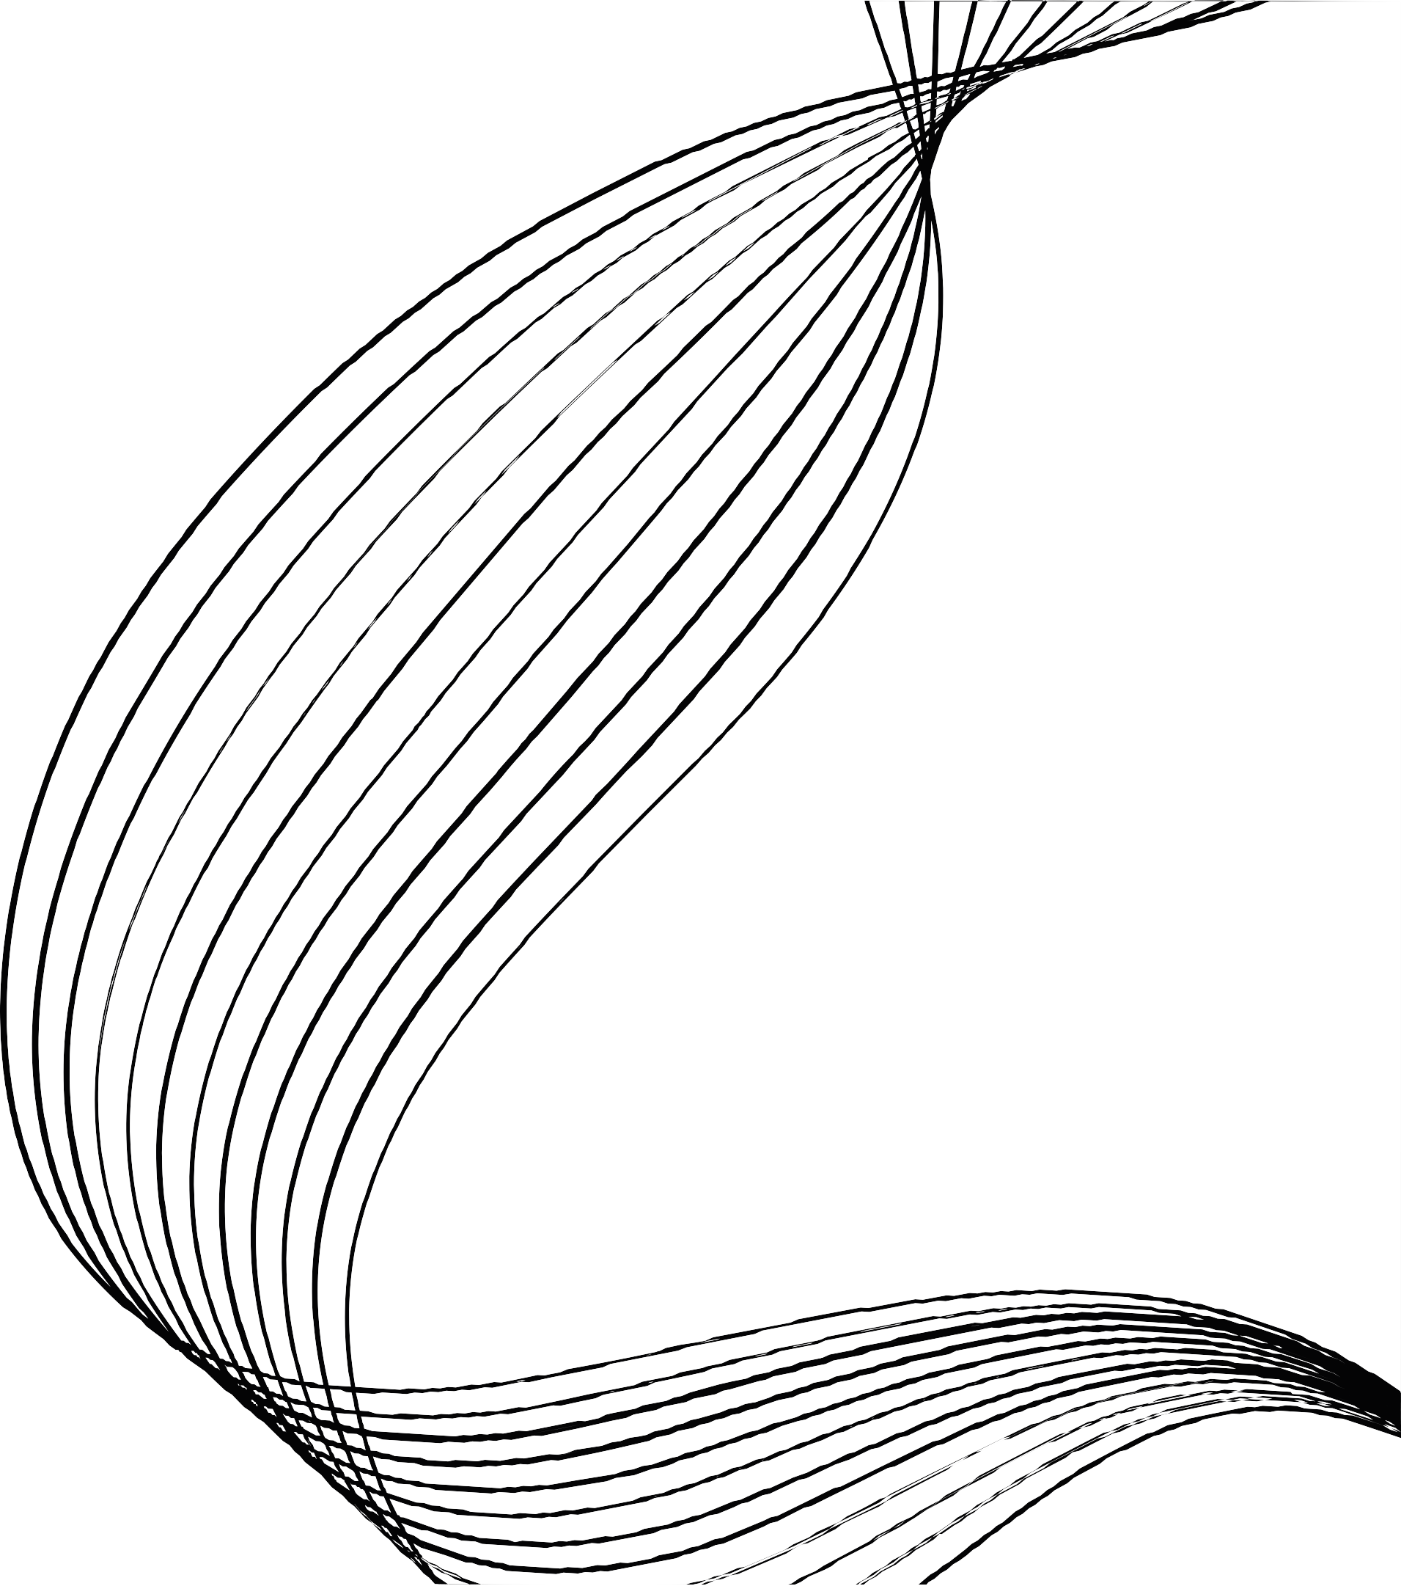
THANK YOU!

